Slide 1

CAP444 OBJECT ORIENTED PROGRAMMING USING C++

Slide 2
Topics Covered
Polymorphism :
functions overloading,
overloading unary operators,
overloading binary operators,
virtual base classes,
abstract classes,
pointer to object,
this pointer,
pointer to derived class,
virtual function,
pure virtual function

Slide 3
Polymorphism
The word “polymorphism” means having many forms.
In simple words, we can define polymorphism as the ability of a message to be displayed in more than one form.
A real-life example of polymorphism is a person who at the same time can have different characteristics. A man at the same time is a father, a husband, and an employee. So the same person exhibits different behavior in different situations. This is called polymorphism.
Polymorphism is considered one of the important features of Object-Oriented Programming.

Slide 4
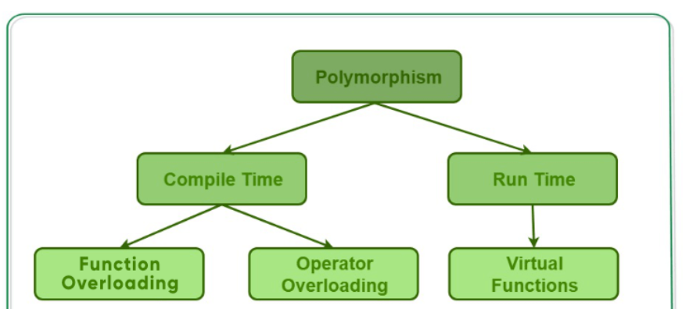
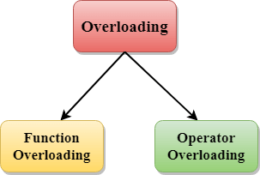
Polymorphism

Slide 5
Functions overloading
When there are multiple functions with the same name but different parameters, then the functions are said to be overloaded, hence this is known as Function Overloading.
Functions can be overloaded by changing the number of arguments or/and changing the type of arguments.
In simple terms, it is a feature of object-oriented programming providing many functions to have the same name but distinct parameters when numerous tasks are listed under one function name.
There are certain Rules of Function Overloading that should be followed while overloading a function..

Slide 6
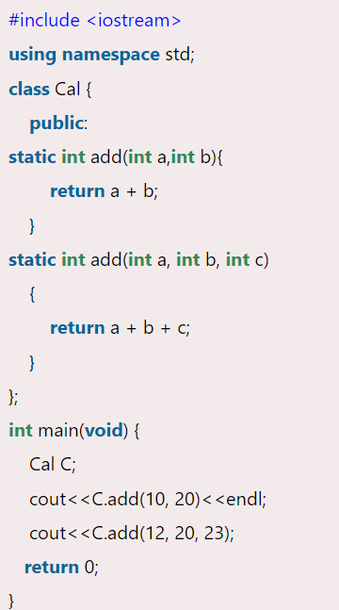

Slide 7
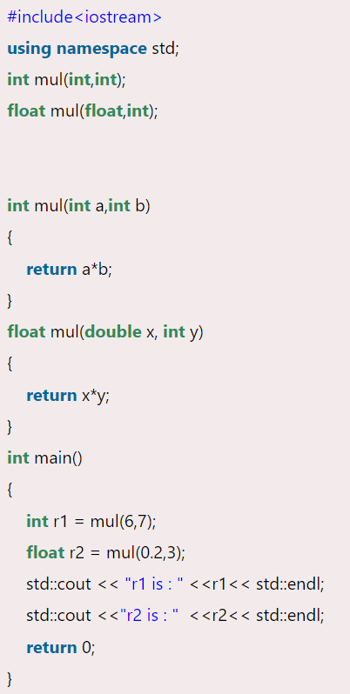

Slide 8
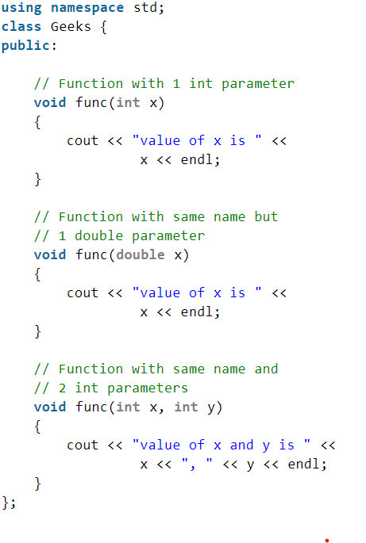
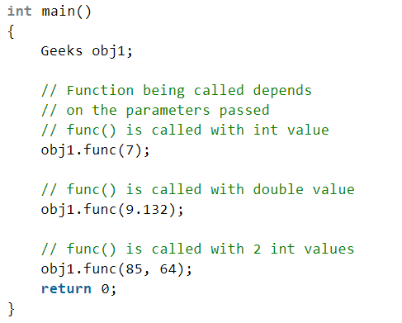

Slide 9
Constructor Overloading
more than one constructor in a class with same name, as long as each has a different list of arguments.This concept is known as Constructor Overloading and is quite similar to function overloading.

Slide 10
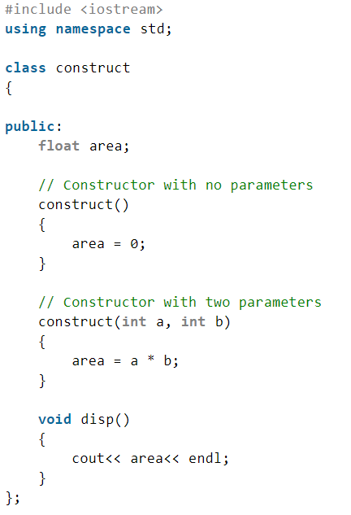
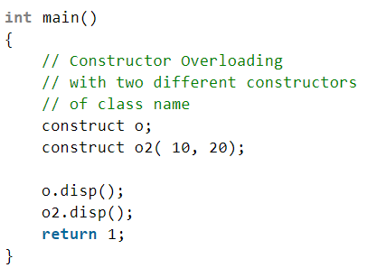

Slide 11
Operator overloading
Operator overloading is a compile-time polymorphism in which the operator is overloaded to provide the special meaning to the user-defined data type.
You can redefine built in operators except few:
Scope resolution operator (::)
sizeof
member selector(.)
member pointer selector(.*)
ternary operator(?:)

Slide 12
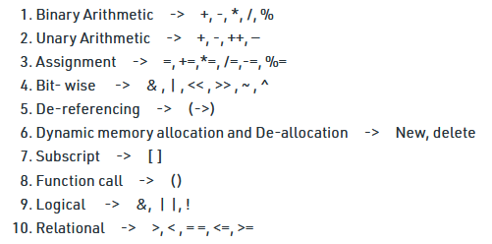
Operators which can overload

Slide 13
Operator that cannot be overloaded are as follows:
Scope operator (::)
Sizeof
member selector(.)
member pointer selector(*)
ternary operator(?:)

Slide 14
Consider this example
class A {
};
int main() { A a1,a2,a3;
a3= a1 + a2;
return 0; }
This is not allowed, because the addition operator “+” is predefined to operate only on built-in data types. But here, “class A” is a user-defined type, so the compiler generates an error. This is where the concept of “Operator overloading” comes in.

Slide 15
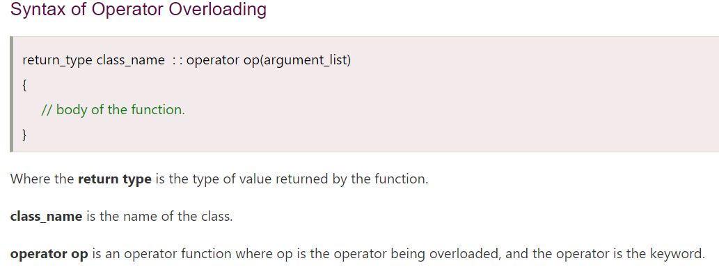
Operator Overloading Syntax:
return_type operator operator_Symbol(parameters)
{
}
Example:
class A {
public:
A operator +(A const &obj)
{
}
};

Slide 16
Rules for Operator Overloading
Existing operators can only be overloaded, but the new operators cannot be overloaded.
The overloaded operator contains atleast one operand of the user-defined data type.
We cannot use friend function to overload certain operators. However, the member function can be used to overload those operators.
When unary operators are overloaded through a member function take no explicit arguments, but, if they are overloaded by a friend function, takes one argument.
When binary operators are overloaded through a member function takes one explicit argument, and if they are overloaded through a friend function takes two explicit arguments.

Slide 17
Operator overloading for Unary operators:
The unary operators operate on a single operand :
The increment (++) and decrement (--) operators.
The unary minus (-) operator.
The logical not (!) operator.

Slide 18
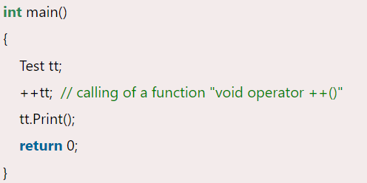
#include <iostream>
using namespace std;
class Test
{
private:
int num;
public:
Test()
{ num=8;
}
void operator ++()
{
num = num+2;
}
void Print() {
cout<<"The Count is: "<<num;
}
};

Slide 19
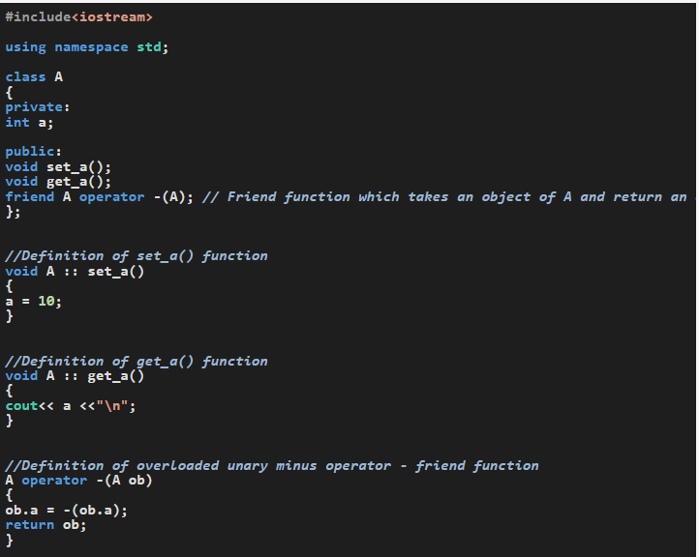

Slide 20
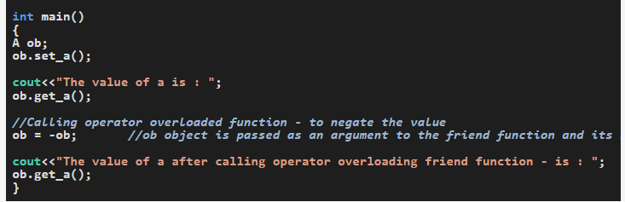
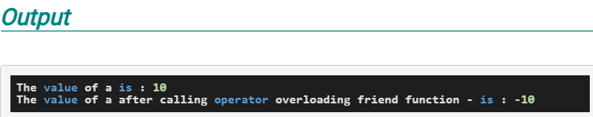

Slide 21
Operator overloading for binary operators:
The binary operators operate on two operands :
+,
-,
*,
/,
%
a+b

Slide 22
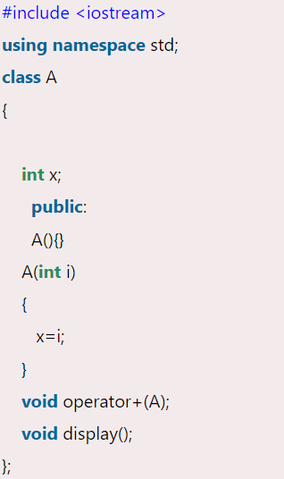
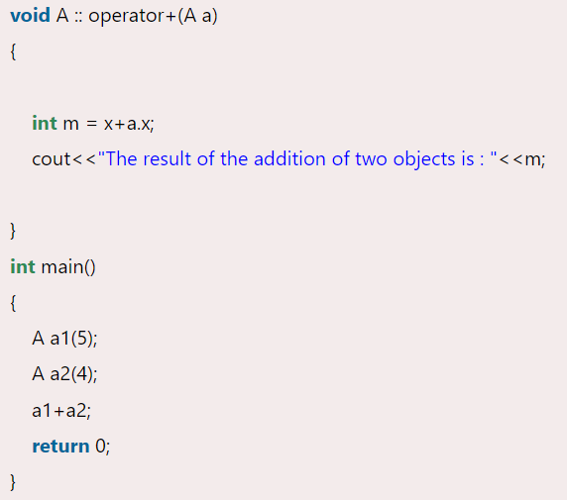

Slide 23
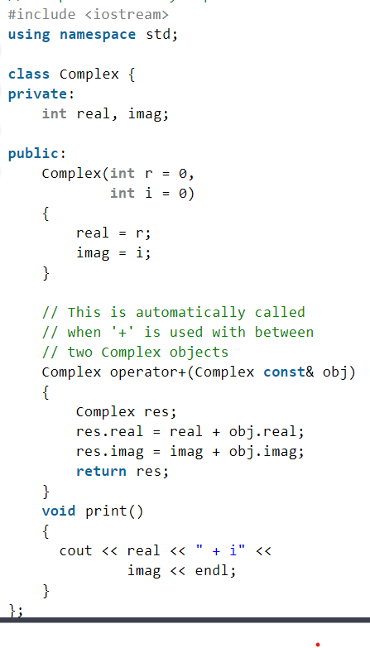
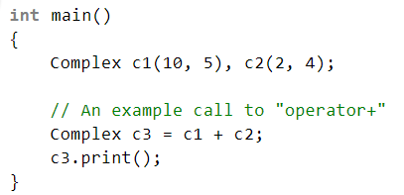
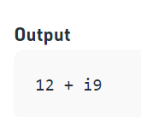

Slide 24
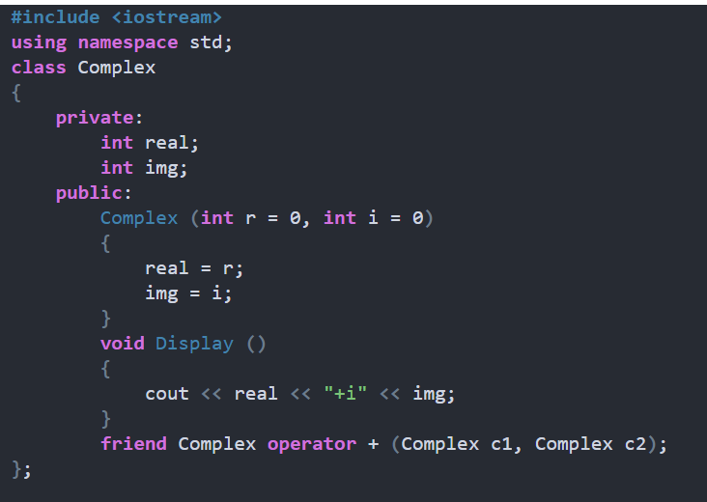
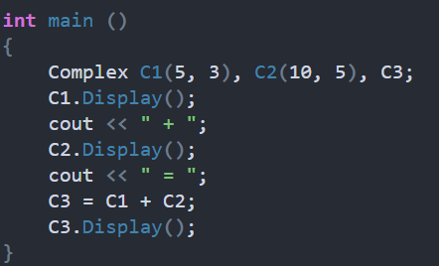
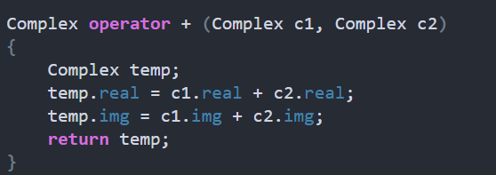
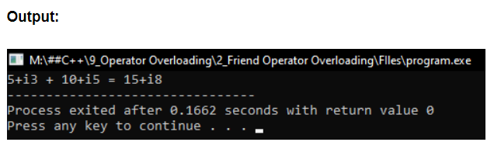

Slide 25
Rules for Operator Overloading
Existing operators can only be overloaded.
The overloaded operator contains at least one operand of the user-defined data type.
When unary operators are overloaded through a member function take no explicit arguments, but, if they are overloaded by a friend function, takes one argument.
When binary operators are overloaded through a member function takes one explicit argument, and if they are overloaded through a friend function takes two explicit arguments.

